Slide 1
Meteorite Landings
Project 3,Group 13
Zachary Dallas
Kelsey Mersinas
Kade Rivers
Marty Thompson

Slide 2
Purpose
This web app explores data through an interactive application. We aim to provide insightful analysis to meteorite landings and their distributions. NASA estimates that any given hour several meteorites can be seen falling through our atmosphere. While most burn up several thousand will still land on our planet this year alone.
By using interactive maps to visualize meteorite landings we can highlight the impact of space on our planet and can show the distributions of these meteorites.
Using both leaflet and javascript we can add information to our plots to paint a picture of how these meteorites are distributed.

Slide 3
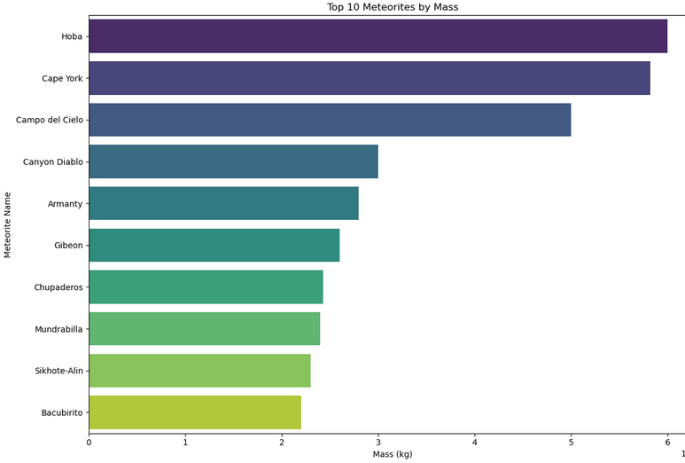
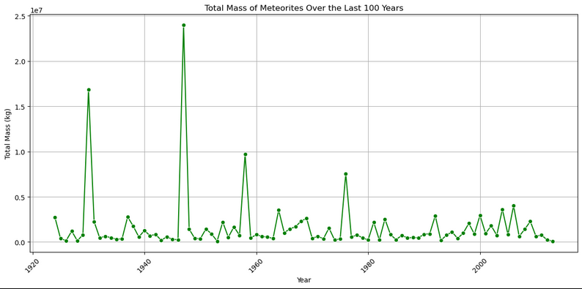
Inspiration
We used our jupyter notebooks to explore the data and initialize our research

Slide 4
Design Concepts
Our data set had locations from all over the world
Maps make an clear and understandable picture of distribution so that we can identify patterns.
A heat map layer can quickly show patterns and can include individual data points.
Using markers can pinpoint more subtle trends and show more detail about meteor showers and their locations.
Plotting changes over time highlight any regularity in size or frequency
Time can be used in a line graph as the constant to display increase or decrease in rate.
With some years having thousands of landings, time can be broken down into smaller units for data exploration.
Breaking down by time and general location we can compare large areas over time and changes in the types of meteorites that are landing.

Slide 5
Research questions:
Are there any common locations where meteorites are touching down?
What are the sizes of these meteorites when they get to earth and are the sizes affecting their landing?
Has the frequency of these landings changed over time?
When looking at the maps, you can see there does seem to be locations where more meteorites touch down in one spot.
It doesn’t seem that the size affects the landing spot, however when a larger meteorite lands, it seems to be accompanied by smaller ones in the surrounding area.
The frequency has seemed to increased over time, whether due to phenomena outside our control or because we are becoming better at finding these meteorites as a whole.

Slide 6
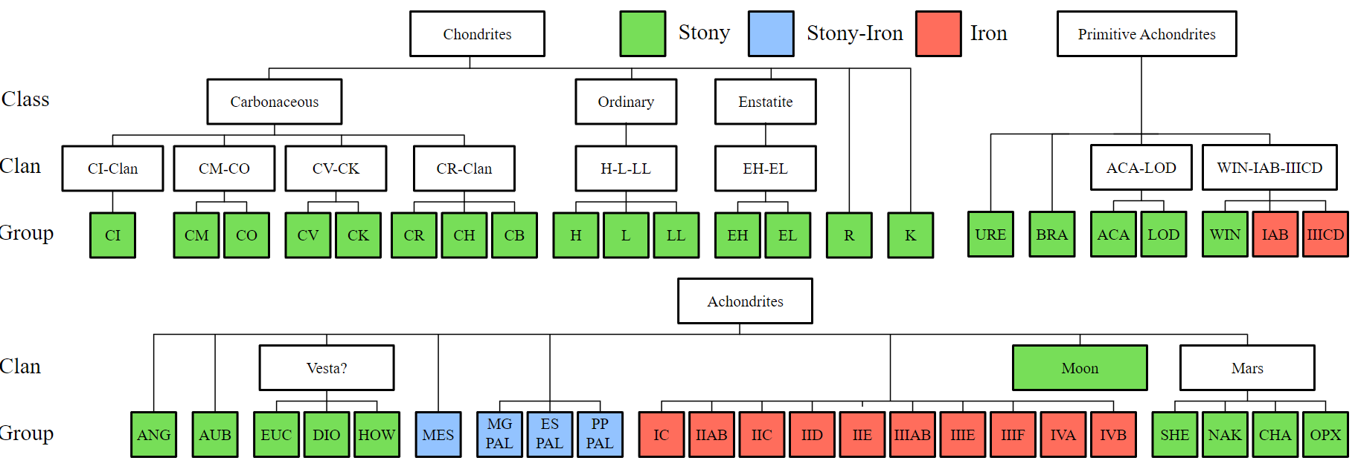
Meteorite Classification
Image attribution: By Tobias1984 - Own work, CC BY-SA 3.0, https://commons.wikimedia.org/w/index.php?curid=23240154
Wikipedia states that “There is no single, standardized terminology used in meteorite classification”
Meteorites may be classified by their genetic makeup, but it is hard to prove the origin for most
Traditional categories: rocky material (stony meteorites), metallic material (iron meteorites), or mixtures (stony–iron meteorites)
Each category is then divided further to be more specific for the composition of the meteorite, but the three traditional categories are the most widely used.
For a glossary of meteorites, click here. For information on asteroid spectral types, click here.

Slide 7
Click Here to check out our web page!

Slide 8
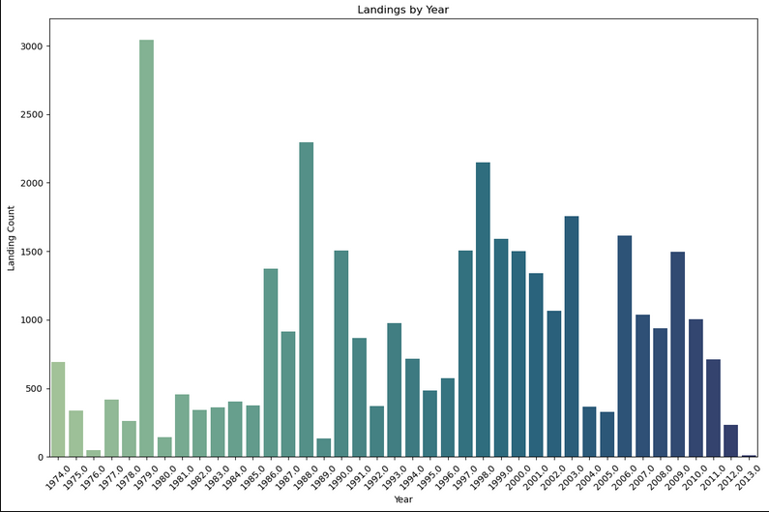
Conclusions
Meteorites are landing all across the globe but in both large groups and individually which can skew counts in certain areas
Sizes can vary from very large to very small, yet the sizes we are seeing in the last 200 years are smaller.
The smaller meteorites end up falling together in meteor showers.
Frequency of landings naturally waxes and wanes - yet the counts we have in our data depend heavily on the technologies we have to detect them.

Slide 9
Limitations and bias
Few limitations
Time…as we worked we thought of new ways to analyze and present.
More research would add a broader analysis of this subject.
Bias that could have influenced data set
Meteorites that have landed in harsh terrain and are left undiscovered.
Communication between the discovery, officials, and Nasa.
Data was very sparse until approximately 1970.
Unknown landings due to remote terrain.
Future work that could potentially be done:
Organization by classification to determine the most common classification-type.
Map visualization based on classification to determine if certain areas are prone to having similar meteorites landing over other areas.
Try to determine why there are outlier years in terms of the number of landings.

Slide 10
Thanks

